Slide 1

https://www.uni-goettingen.de/en/48115.html
Unless I explicitly state otherwise, images and cartoons are created using ChatGPT.
You may use this material free of charge under the terms of the CC BY license. This requires that you provide appropriate attribution to the author: W. Link, University of Goettingen, Germany.
In a few cases, individual images, photographs, or similar material may be subject to a more restrictive Creative Commons license. Where this applies, it is explicitly indicated, and you must comply with the stated license terms for those items.
Please check the license information carefully before reuse. Responsibility for complying with the applicable license terms rests entirely with you.
UNPLAB-h²_GxE_Ch-3[BLUP]
Variance between phenotypic data.
Variance between between genotypic data.
Variance between between estimates of genotypic data.

Slide 2
Sequential Number: #15
UNPLAB-h²_GxE_Ch-3[BLUP]
2

Slide 3
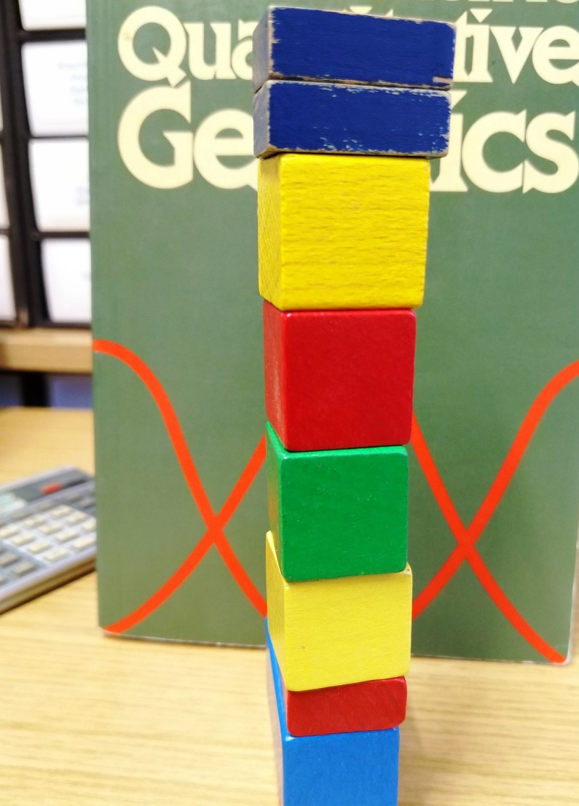
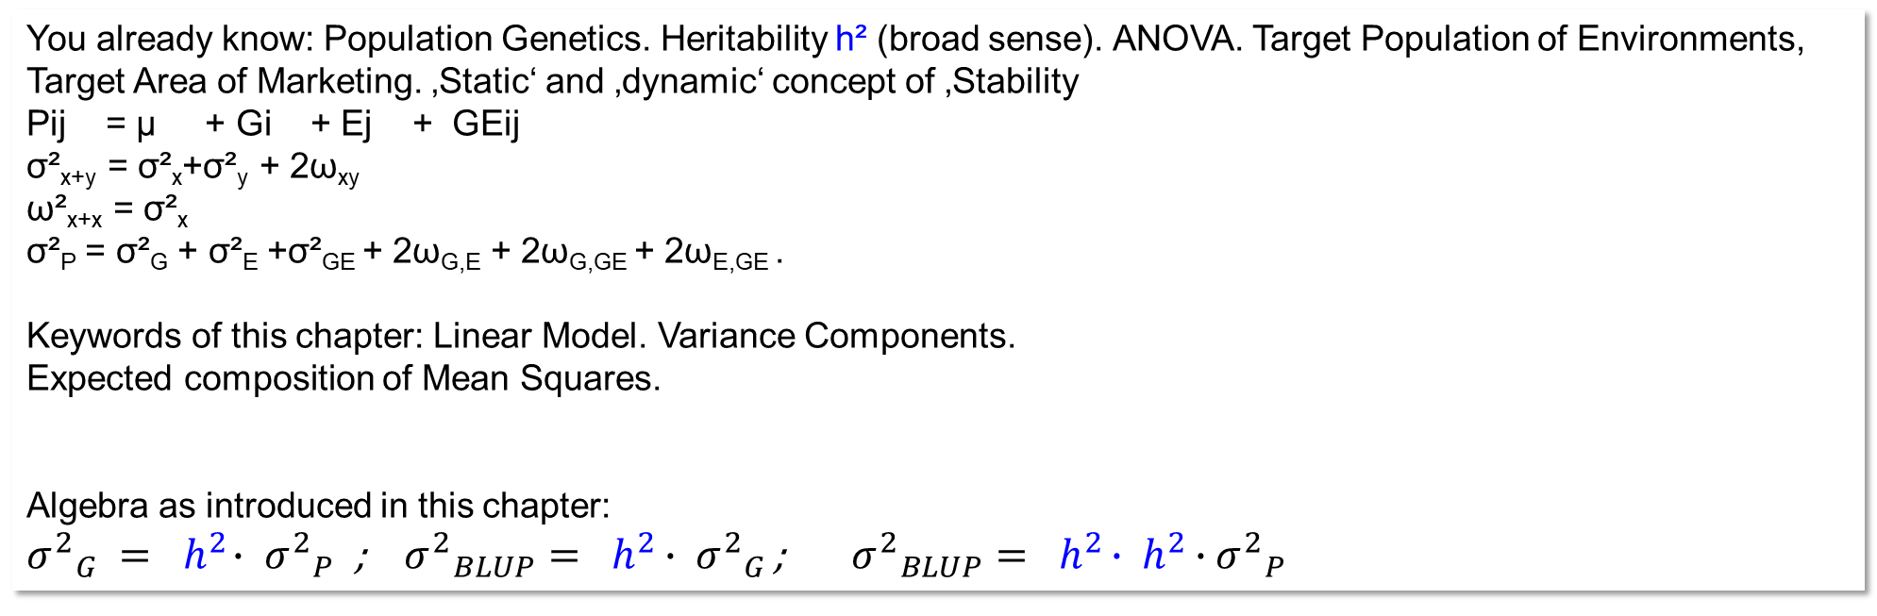
You already know: Population Genetics. Heritability h² (broad sense). ANOVA. Target Population of Environments, Target Area of Marketing. ‚Static‘ and ‚dynamic‘ concept of ‚Stability
Pij = µ + Gi + Ej + GEij
σ²_{x+y} = σ²_{x}+σ²_{y} + 2ω_{xy}
ω²_{x+x} = σ²_{x}
σ²_{P} = σ²_{G} + σ²_{E} +σ²_{GE} + 2ω_{G,E} + 2ω_{G,GE} + 2ω_{E,GE} .
Keywords of this chapter: Linear Model. Variance Components.
Expected composition of Mean Squares.
Algebra as introduced in this chapter:
${σ^{2}}_{G }{ = h}^{2}∙ {σ^{2}}_{P}$; ${σ^{2}}_{BLUP}{= h}^{2 }∙ {σ^{2}}_{G }$; ${σ^{2}}_{BLUP}{= h}^{2 }∙{ h}^{2 }∙{σ^{2}}_{P }$
© WL
3

Slide 4
Data from field testing 11 pea cvs. across 12 environments.
Hilke Riemer and Wolfgang Link, 2004 (Pflanzenbauwissenschaften 8, 16-23).
Orthogonal data set: Each entry is tested at each environment.
By the way.
For us plant breeders, it is slightly strange to think that our genotypes are treatments. We would think that fertilisation or irrigation or pesti-cide application or sowing time etc. are decent ‘treatments’. But for the statistician, our genotypes are treatments just as if we sprayed the genotype on so-far amorph-anonymous green-biomass plots ;-) ...
In cases of genotypes and even further treatments (such as sowing time ...), our basic idea of ‘orthogonality’ is applied and implemented accordingly.
4

Slide 5
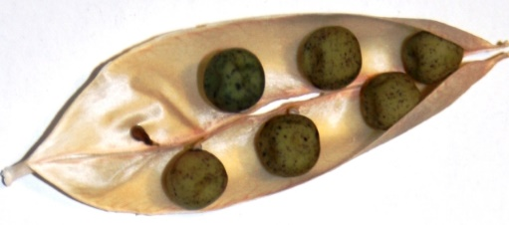
Via ANOVA, broad-sense heritability h² and variance components can be estimated.
Ponder our field data: 11 pea cvs. in 12 environments.
The genotype main effects such as G_{i} = -10.4 dt/ha for Monamy are not fully ‘true’. For instance, with means across E=12, the variance among these effects is expectedly inflated by 1/12 of the GxE variance.
This statistical expectation is
exploited in the ANOVA. It is the
basis to (1) explicitly estimate
the GxE variance and (2) ‚clean‘
the variance between the cvs’. main effects from such ‚pollution‘ by GxE. The then-‚cleaned‘ G variance is the estimate of the ‘purely’ genetic (genotypic) variance between the cultivars.
This-then is the variance between these cvs. that would be expected if the series of experiments was not carried out across E=12 environments but across E=∞ environments (always assuming that the sites and years were well representing the Target Marketing Area).
ANOVA: Analysis of variance
Nota bene: As simplification, we consider each Year x Location combination as one ‚Environment‘;
We took data that were already means across the replicates within the single-environments (to make it easy).
5

Slide 6
Via ANOVA, broad-sense heritability h² and variance components can be estimated.
When subtracting [MS_{GE}] from [MS_{G}], we – obviously, figure out by yourself – isolate σ²_{G}.
Hm … nearly so. We divide by the number of envs. (E=12 in our data set), then, after that division, we ‚find‘ σ²_{G}. That resulting figure now is the variance component due to the genotypes; the estimate of the purely genetic variance.
Such variance component and the understanding of how it is calculated and what it really means allows a deeper glance on Quantitative Genetics ;-).
It does not allow to actually tell by which amount the phenotypic effect of e.g. Monamy, g_{i=1} = -10.4 dt/ha was GxE-inflated. We yet tend to conclude that the pheno-typic variance should be shrinked by a factor h² to estimate the genetic variance.
And we may shrink each cv.’s superiority (or inferiority) by factor h² to admit that the phenotypic effects are polluted by some GxE and error and only a fraction h² of it is thought to be true and genetic (genotypic).
E{MS}says: Expected composition of Mean Squares. We equate such expected MS to the observed MS.
A bold and indigenous step.
Divide [MS_{G}] by E=12, get the σ²_{P}.
Divide [MS_{G}]-[MS_{GE}] by E=12, get the σ²_{G} (estimate of it).
Divide σ²_{G} / σ²_{P} , get: factor h² = σ²_{G} /σ²_{P} (estimate of it).
Calculate h² ∙ σ²_{P} and get: σ²_{G} (estimate of it).
6

Slide 7
Via ANOVA, broad-sense heritability h² and variance components can be estimated.
© Peer Urbatzka
Witzenhausen, 2009
Meanwhile, h = (h²)^{½} is oftentimes called ‚Accuracy’ of selection‘; this is to make the classical concept and wording better fit to the current world.
See: UNPLAB-BrMeth_Ch-11[TheFour GS]
The ‘predictive ability’ ρ = σ_{GEBV} / σ_{P}
The ‘accuracy’ Accur = σ_{GEBV} / σ_{G}
Heritability (h²)^{½} = σ_{G} / σ_{P}
σ²_{GEBV} is that part of σ²_{G} which is ‘explained’ by the model-of-Genomic-Prediction ...
Divide [MS_{G}] by E=12, get the σ²_{P}.
Divide [MS_{G}]-[MS_{GE}] by E=12, get the σ²_{G} (estimate of it).
Divide σ²_{G} / σ²_{P} , get: factor h² = σ²_{G} /σ²_{P} (estimate of it).
Calculate h² ∙ σ²_{P} and get: σ²_{G} (estimate of it).
7

Slide 8
ANOVA tables, alas, do not directly display σ²_{P}. Here, the Mean Square MS_{G} = 322.663 is the E-fold (E=12) of the phenotypic variance σ²_{P} among these 11 pea cultivars.
8
BEFORE (or, say, without) cleaning from MS_{GE}
322.663 / 12 = 26.889; this is the variance between the main effects of the G=11 cultivars (we saw this earlier here
as „σ²_{cvs.} = 26.9 (dt/ha)²”. It is the phenotypic variance between cultivars; cvs.’ data as their means across our E=12.
AFTER cleaning of from MS_{GE}.
[322.662-29.642] / 12 = 24.418 (dt/ha)²
Ratio: h² = 24.418 / 26.889 = 0.908. Why is it that high – event though the trait is grain yield? First, because E=12 is a large number. Second: These pea cvs. covered a markedly large variation of performance, and it rather easy to find via field experiments their ~true ranking. In a more narrow competition between elite material, h² is lower.

Slide 9
9
Estimate a variance component without software: Do a ‘self’-tinkered ANOVA …
11 Cultivars
The variances between the 11 cvs. in one of the 12 envs. were 20.05 < σ² < 135.83, on average it was 54.06 and expectedly contains σ²_{G} + 1∙σ²_{GE}. The variance between the 11 means of these cvs. across all environments was
σ² = 26.89. It includes expectedly 1/12 of σ²_{GE}. Therefore we can estimate σ²_{GE} = (54.06-26.89)(12/11)= 29.64.
With this, we ‚clean‘ our phenotypic variance and estimate the ‘pure’ σ²_{G} = 26.89 – (29.64/12) = 24.42 (dt/ha)².

Slide 10
Estimate a variance component without software: Do a ‘self’-tinkered ANOVA …
Just read it again. Enjoy the thrill of mentally penetrating this mystical thing.
10
The variances between the 11 cvs. in one of the 12 envs. were 20.05 < σ² < 135.83, on average it was 54.06 and expectedly contains σ²_{G} + 1∙σ²_{GE}. The variance between the 11 means of these cvs. across all environments was
σ² = 26.89. It includes expectedly 1/12 of σ²_{GE}. Therefore we can estimate σ²_{GE} = (54.06-26.89)(12/11)= 29.64.
With this, we ‚clean‘ our phenotypic variance and estimate the ‘pure’ σ²_{G} = 26.89 – (29.64/12) = 24.42 (dt/ha)².

Slide 11
ANOVA. More complex. Genotypes, Years, Locations, Replicates (Y=2, L=6, R=3).
Heritability is estimated here as h² = 0.846 ≠ 0.908. Patiently inspect the expected composition of the Mean Squares. You deduce [MS_{GL} + MS_{GY} ] from the MS_{G} and then add MS_{R(GLY)}; then divide by RLY=36 to isolate the Variance Component termed ‘genetic’.
11

Slide 12
ANOVA. Same principle, just more complex. Genotypes, Years, Locations, Replicates.
12
► σ²_{G} = (968.00-51.89-141.129+44.12)/36 = 22.75 σ²_{P} = 968.00/36=26.89 h² = 22.75/26.89 = 0.846
Directly dividing the MS_{G} by 36 yields the phenotypic variance, σ²_{P} = 26.89; seen before. h² estimate here is slightly smaller than before (0.846<0.908), because here, we admit that the environments were – truly – 6 locations and 2 years instead of 12 ‘envs.’. Mind, we employed the same six locations in the two years. This violated the assumption when taking these as 12 ‘environments’: “They are not structured but are 12 independent environments sampled from the Total Pool of Environments”. E=12 from Y=2 times L=6 is, and E is taken as random effect ( a bit cheating?).

Slide 13
Application ;-)
13

Slide 14
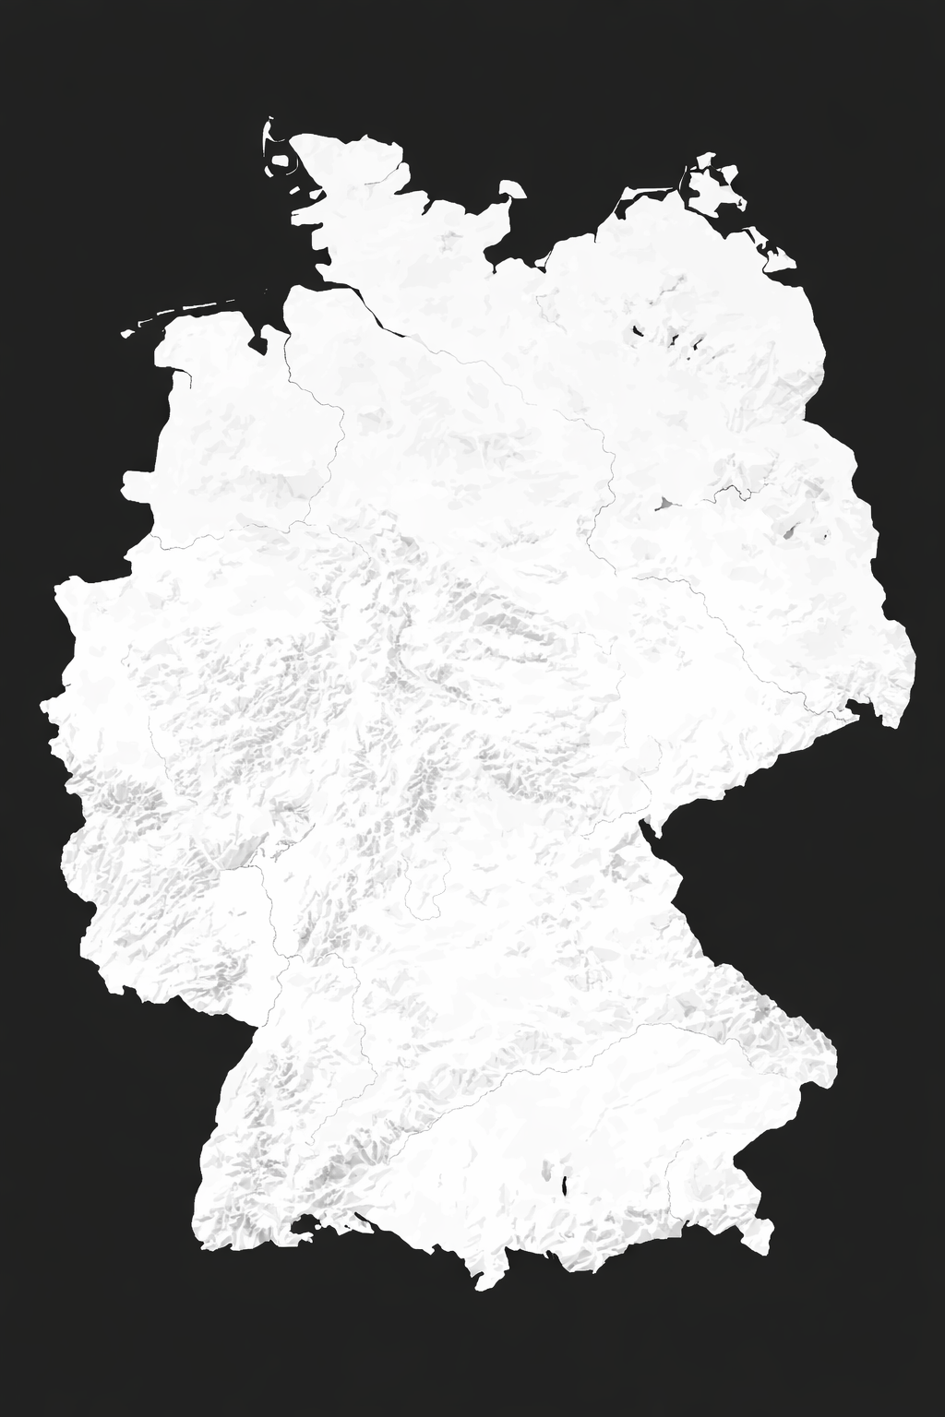
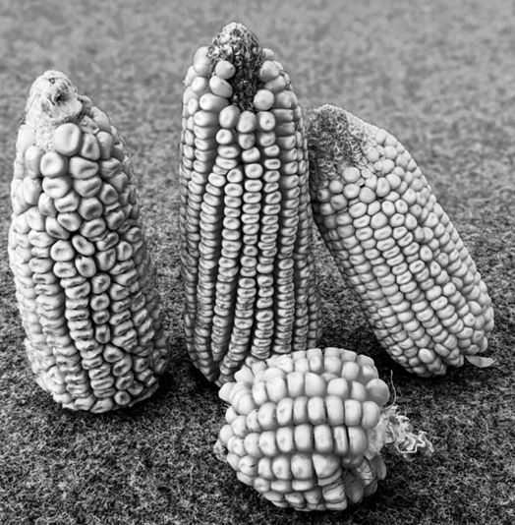

Assume: You have just enough seed for R=6 field plots – and you want to assess mean performance in your Target Area of Marketing. How to allocate plots to locations?
RCBD means randomized complete block design; rather default.
… or, more realistic: how to allocate the six available field plots per candidate to locations, to years, to replicates?
You may test at 1 location in 1 year with RCBD and R=6.
You may test at 1 location in 3 years with RCBD and R=2.
You may test in 3 locations in 1 years with RCBD and R=2.
You may test at 2 locations in 3 years with R=1 per each trial.
You may test at 3 locations in 2 years with R=1 per each trial.
The h² of allocations A-E could be studied if we had estimates of variance components. See estimates for maize grain yield (dt/ha)²; DOI 10.1111/j.1439-0523.2008.01564.x; Y. Wang 2022).
σ²_{RGLY}=7 σ²_{GLY}=9 σ²_{GL}=6 σ²_{GY}=4 σ²_{G}=17
σ²_{P} = σ²_{RGLY}/RLY + σ²_{GLY}/LY + σ²_{GL}/L + σ²_{GY}/Y + σ²_{G}
h² = σ²_{G} / σ²
© Tim Beissinger
2026
14

Slide 15
How to allocate a restricted number of plots – to maximize h² and thus success?
15
(A) You may test at one location in one year with RCBD and R=6.
h² is 17.00/37.17 = 0.457
(B) You may test at 1 location in 3 years with RCBD and R=2.
h² is 17.00/28.50 = 0.596
(C) You may test in 3 locations in 1 years with RCBD and R=2.
h² is 17.00/27.17 = 0.626
(D) You may test at 2 locations in 3 years with R=1 per each trial.
h² is 17.00/24.00 = 0.708
(E) You may test at 3 locations in 2 years with R=1 per each trial.
h² is 17.00/26.67 = 0.718
σ²_{P} = σ²_{RGLY}/RLY + σ²_{GLY}/LY + σ²_{GL}/L + σ²_{GY}/Y + σ²_{G}
Take home message: The single plot error σ²_{e} = σ²_{R(GLY)} = was divided by factor 6 ‚anyway‘, whether this factor results from RLY=1∙1∙6=6 or from 2∙3∙1=6 or from 3∙2∙1=6. Yet, the further inter-action components are reduced by such division the more, the more L>1 and Y>1 (even if due to this R must become smaller than 6).
If you test in but one environment, then your selection is specific for that environment. If you test in several environments, then the result of your selection is better buffered for GxE interactions.
© Tim Beissinger
2026

Slide 16
How to allocate a restricted number of plots – to maximize h² and thus success?
(D) You may test at 2 locations in 3 years with R=1 per each trial.
h² is 17.00/24.00 = 0.708
(E) You may test at 3 locations in 2 years with R=1 per each trial.
h² is 17.00/26.67 = 0.718
σ²_{P} = σ²_{RGLY}/RLY + σ²_{GLY}/LY + σ²_{GL}/L + σ²_{GY}/Y + σ²_{G}
The ratio σ²_{GL}/ σ²_{GY} is 6 / 4 = 1.5; hence, it was optimum to invest 1.5-fold into locations vs. into years, such as L=3 and Y=2. If - for instance - σ²_{GL}=24 and still σ²_{GY}=4 (larger area of marketing; or different germplasm; or different trait) … then it would be optimum to employ (24/4=6) six times as many locs. as years, such as L=6 and Y=1 or, with larger budget, L=12 and Y=2.
This are expectations. Any real two hot years to test-and-select followed by a wet year to validate-and-realize will teach us patience and modesty.
h² is not the only adjusting screw, not the only lever to influence efficiency of breeding. Others are e.g. the amount and type of genetic diversity to select from; and the intensity of selection; and the time elapsing between cycles of breeding.
See later: UNPLAB-h²_GxE_Ch-5[BreedersEquation]
© Tim Beissinger
2026
16

Slide 17
Since our data from 11 pea cvs. are experimental data, we do not know the Genotypic data. Yet, I invented them in a way to cause h²=0.908 as we found via ANOVA. With this, we now (again) can en detail study the regression of G on P and the deviations of the G values from this regression line.
See in the next pages.
Eventually we will reach the point where the concept and the idea of the so-called BLUPs seems to come naturally to us, with limited effort.
17

Slide 18

18

Slide 19
-8
-4
0
4
8
Such a pity that we do not know the true G values of our 11 pea cvs. Can we invent them, just to please us? Well, yes, we can ;-)
74
Phenotypic effects (E=12)
72
8
70
68
4
The regression coefficient of the here-invented ‘true’ G-values on the P-data (E=12) is of course h² = 0.908. ;-) Slightly smaller than 1 as you see from the comparison with the diagonal line. Note* that the P-values vary slightly more than these G-values. This is caused by the residual variance of 1/12 of σ²_{GE} included in the P data (which are means across E=12).
The variance of the ‘true’ G values (or, if you like, between their effects) is of course σ²_{G} = 24.418 (as estimated earlier via ANOVA).
66
64
0
‘True' G values ; BLUPs as values
‘True' G effects; σ²_{G} = 24.418
62
60
-4
58
Dots on the regression line
56
-8
54
52
52
54
56
58
60
62
64
66
68
70
72
74
Phenotypic values (E=12)
*G span is 54.15 – 70.67;
P span is 53.19 – 71.38
19

Slide 20


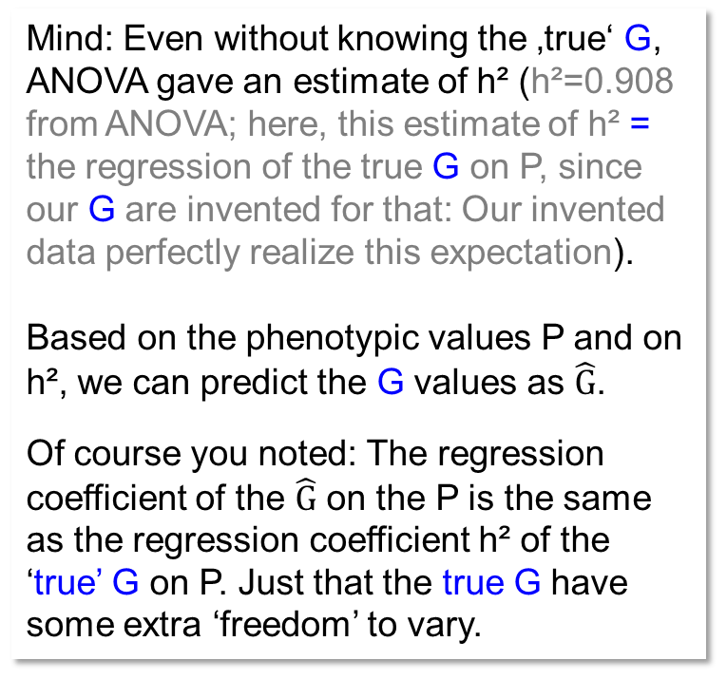
-8
-4
0
4
8
Phenotypic data can lead to ‘untrue’ rank positions and can mislead us as we select.
74
Phenotypic effects (E=12); σ²_{P} = 26.889
72
8
70
68
Mind: Even without knowing the ‚true‘ G, ANOVA gave an estimate of h² (h²=0.908 from ANOVA; here, this estimate of h² = the regression of the true G on P, since our G are invented for that: Our invented data perfectly realize this expectation).
Based on the phenotypic values P and on h², we can predict the G values as $\hat{G}$.
Of course you noted: The regression coefficient of the $\hat{G}$ on the P is the same as the regression coefficient h² of the ‘true’ G on P. Just that the true G have some extra ‘freedom’ to vary.
4
Ranks 5th
in G data
66
64
0
$\hat{G}$ as effects; σ²$\hat{G}$ = 22.1824
‘True' G values; $\hat{G}$ as values
‘True' G effects; σ²_{G} = 24.418
62
Ranks 5th P data
60
-4
58
BLUP
56
-8
54
52
52
54
56
58
60
62
64
66
68
70
72
74
Phenotypic values (E=12)
20

Slide 21
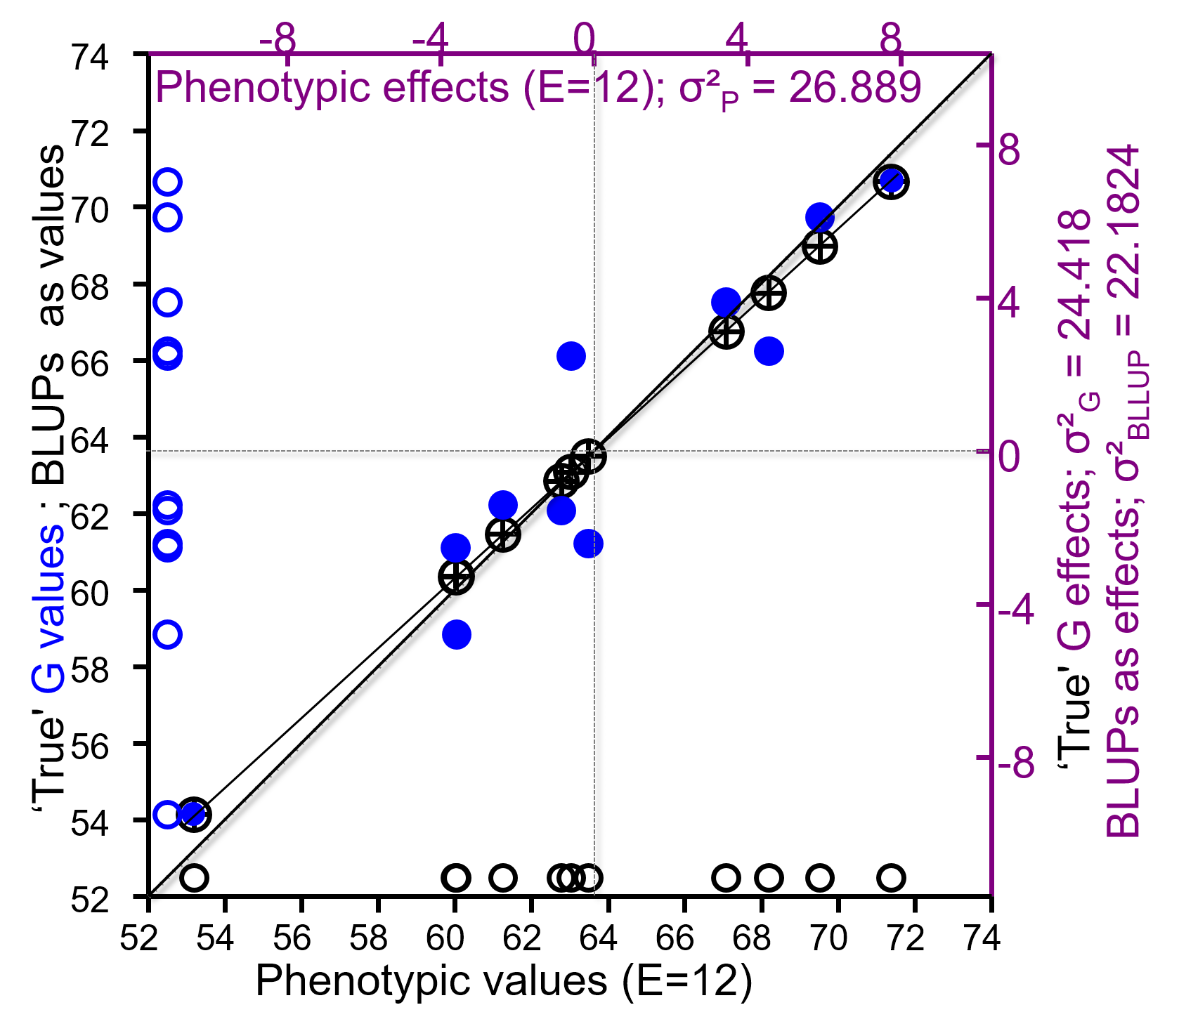
BLUP, best linear unbiased predictors, allow to appreciate differences in h² among candidates.
Imagine some cvs. were tested in E<12 environments; lower h². Their G effect was shrinked correspondingly stronger. BLUPs allows even then adequate comparisons (even if h² differs between entries). Nice!
21

Slide 22
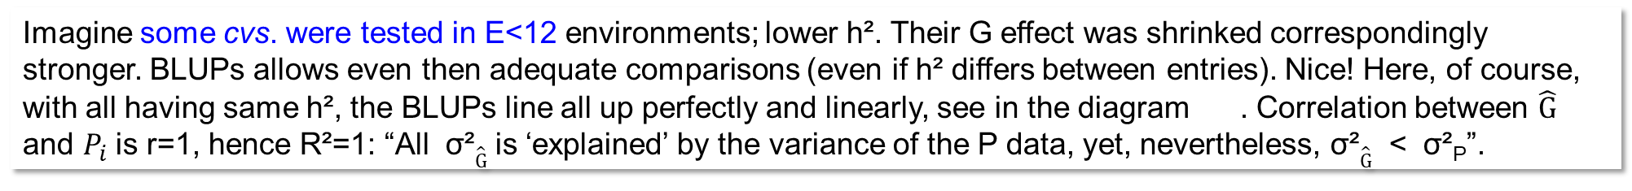
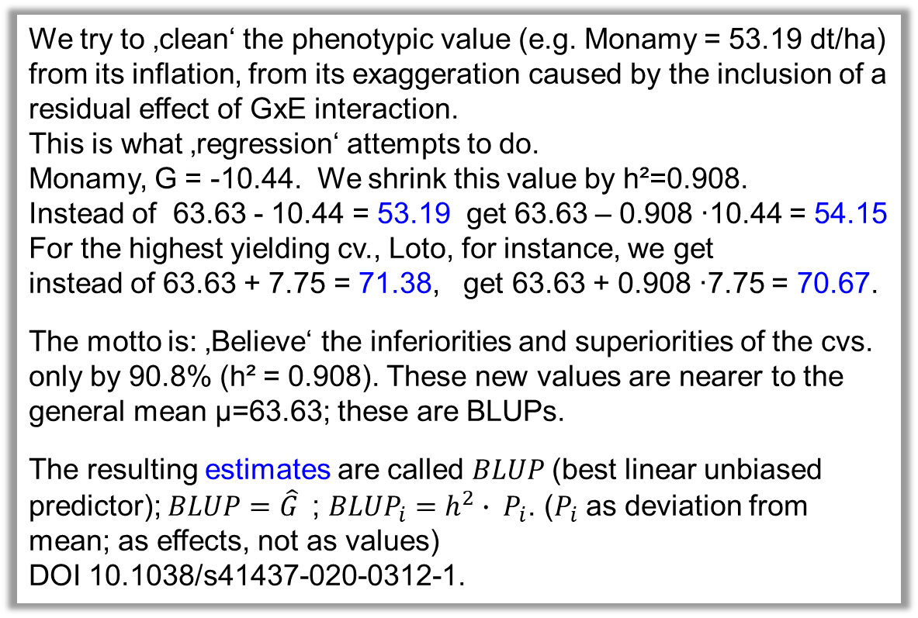
BLUP, best linear unbiased predictors, allow to appreciate differences in h² among candidates.
We try to ‚clean‘ the phenotypic value (e.g. Monamy = 53.19 dt/ha) from its inflation, from its exaggeration caused by the inclusion of a residual effect of GxE interaction.
This is what ‚regression‘ attempts to do.
Monamy, G = -10.44. We shrink this value by h²=0.908.
Instead of 63.63 - 10.44 = 53.19 get 63.63 – 0.908 ∙10.44 = 54.15
For the highest yielding cv., Loto, for instance, we get
instead of 63.63 + 7.75 = 71.38, get 63.63 + 0.908 ∙7.75 = 70.67.
The motto is: ‚Believe‘ the inferiorities and superiorities of the cvs. only by 90.8% (h² = 0.908). These new values are nearer to the general mean µ=63.63; these are BLUPs.
The resulting estimates are called $BLUP$(best linear unbiased predictor); $BLUP=\hat{G}$; ${BLUP}_{i}=h^{2}∙ P_{i}$. ($P_{i}$ as deviation from mean; as effects, not as values)
DOI 10.1038/s41437-020-0312-1.
Imagine some cvs. were tested in E<12 environments; lower h². Their G effect was shrinked correspondingly stronger. BLUPs allows even then adequate comparisons (even if h² differs between entries). Nice! Here, of course, with all having same h², the BLUPs line all up perfectly and linearly, see in the diagram . Correlation between $\hat{G}$ $\text{and} P_{i}$ is r=1, hence R²=1: “All σ²$\hat{G}$ is ‘explained’ by the variance of the P data, yet, nevertheless, σ²$\hat{G}$ < σ²_{P}”.
22

Slide 23
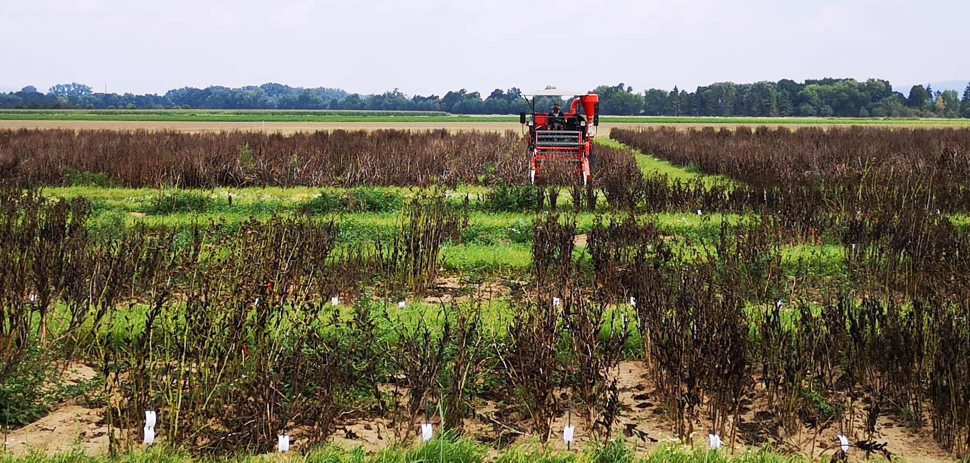
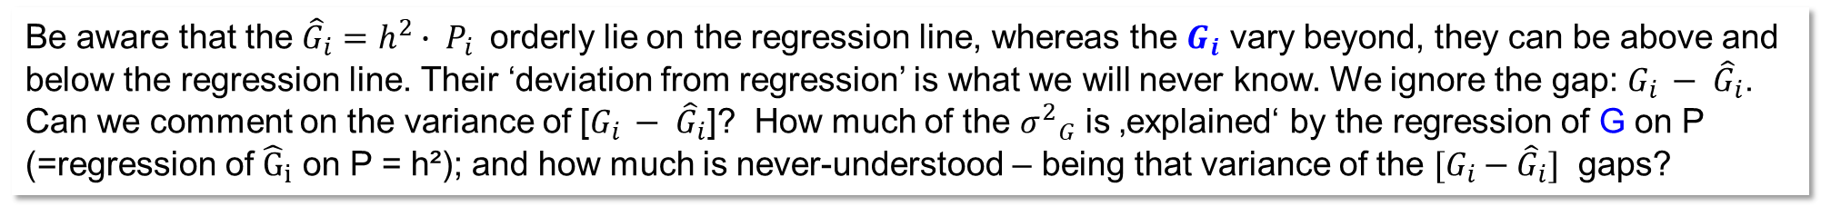

Here, $G_{i}$ denotes the genetic effect of a genotype, unpolluted from GxE and error.
Here, we write $P_{i }$ for the phenotypic effect (data may be means across E=12; or across E=2; or from just one environment E).
Here, we write $G_{i }\text{for} \text{the} \text{true} \text{genetic} \text{effect}\text{. }$
$\text{We} \text{write} {\hat{G}}_{i}$ for the estimate of a genetic effect (BLUP).
What we do is: ${\hat{G}}_{i}=h^{2}∙ P_{i }$
What we would like to do is: ${\hat{G}}_{i}= G_{i } = {(P}_{i })− {(G}_{ }E_{ })ij$
The latter cannot be done.
How should we estimate a true GE interaction effect of a single candidate without knowing its true $G_{i }$ ?
From our field data and from P_{ij}=µ+G_{i}+E_{j}+GE_{ij} .. we get esti-mates, since our P_{ij} data is from a limited number of E. Our µ is not the true µ, hence our G_{i}, our E_{j} and our GE_{ij} are ‘only’ esti-mates as well. We just do not know the ‘truth’.
Do you have an idea to solve this?
Be aware that the ${\hat{G}}_{i}=h^{2}∙ P_{i }$ orderly lie on the regression line, whereas the $G_{i}$ vary beyond, they can be above and below the regression line. Their ‘deviation from regression’ is what we will never know. We ignore the gap: $G_{i }− {\hat{G}}_{i}$.
Can we comment on the variance of [$G_{i }− {\hat{G}}_{i}$]? How much of the ${σ^{2}}_{G}$ is ‚explained‘ by the regression of G on P (=regression of ${\hat{G}}_{i}$ on P = h²); and how much is never-understood – being that variance of the ${[G}_{i }− {\hat{G}}_{i}]$ gaps?
23

Slide 24
Interjection. If data is effects, then va-riance is mean of the squared data ☺
50
40
Point of inflexion
30
SD
Occurence (absolute number)
20
10
0
Mean
0
10
20
30
40
50
60
70
80
90
100
Value (body height cm)
The distance between the point of inflexion and mean is the Standard Deviation (SD); its square is the variance, the square-area visualized its size.
Mind: Not all data is normally distributed, although we tend to assume this …
24

Slide 25
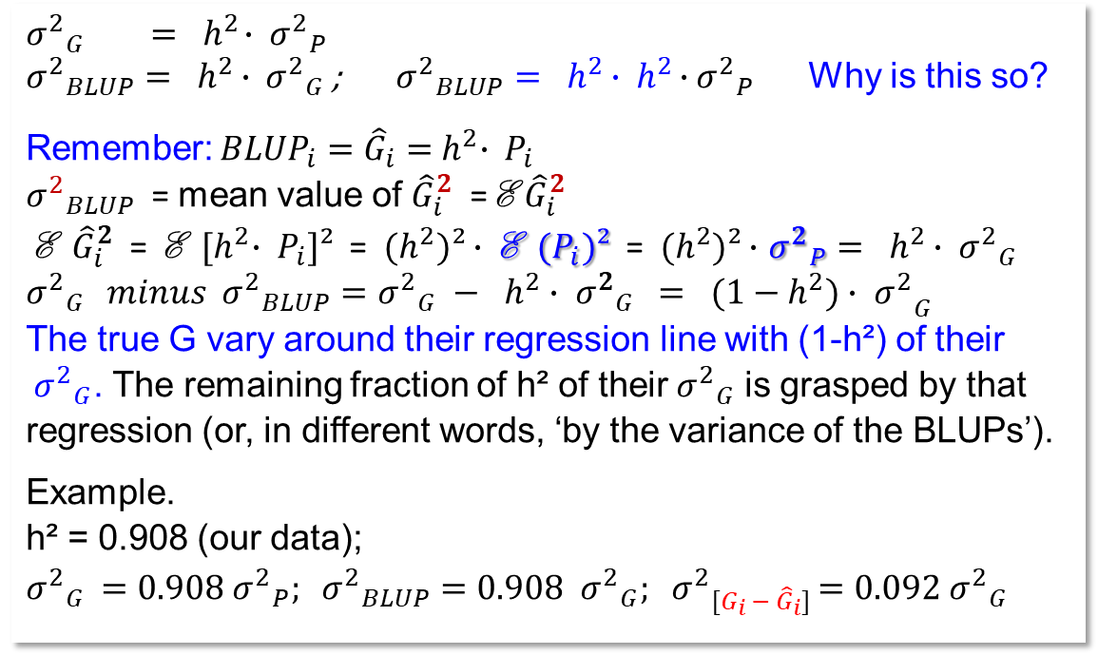
How much of the ${σ^{2}}_{G}$ is ‚explained‘ by the regression of G on P and how much is never-understood – being the variance of ${[G}_{i }− {\hat{G}}_{i}]$ ?
$${σ^{2}}_{G }{ = h}^{2}∙ {σ^{2}}_{P}$$
${σ^{2}}_{BLUP}{= h}^{2 }∙ {σ^{2}}_{G }$; ${σ^{2}}_{BLUP}{= h}^{2 }∙{ h}^{2 }∙{σ^{2}}_{P }$ Why is this so?
Remember: ${BLUP}_{i}={\hat{G}}_{i}={ h}^{2}∙ P_{i}$
${σ^{2}}_{BLUP}$ = mean value of ${\hat{G}}_{i}^{2}$ = E ${\hat{G}}_{i}^{2}$
E ${\hat{G}}_{i}^{2}$ = E ${[h}^{2}∙ P_{i}]²$ = ${(h}^{2})²∙$ E ${(P}_{i})²$ = ${(h}^{2})²∙$ ${σ^{2}}_{P}{= h}^{2 }∙ {σ^{2}}_{G }$
${σ^{2}}_{G } minus {σ^{2}}_{BLUP}={σ^{2}}_{G} − h^{2}∙ {σ^{2}}_{G} { {{= (1−h}^{2})∙ σ}^{2}}_{G}$
The true G vary around their regression line with (1-h²) of their ${{ σ}^{2}}_{G}$. The remaining fraction of h² of their${{ σ}^{2}}_{G}$ is grasped by that regression (or, in different words, ‘by the variance of the BLUPs’).
Example.
h² = 0.908 (our data);
${σ^{2}}_{G }=0.908 {σ^{2}}_{P}; {σ^{2}}_{BLUP}{=0.908}^{ }{σ^{2}}_{G}{{; σ}^{2}}_{{[G}_{i }− {\hat{G}}_{i}]}{{=0.092 σ}^{2}}_{G}$h²
h²=0.908
25

Slide 26
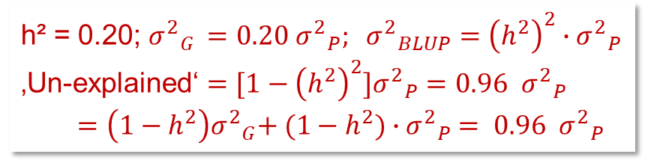
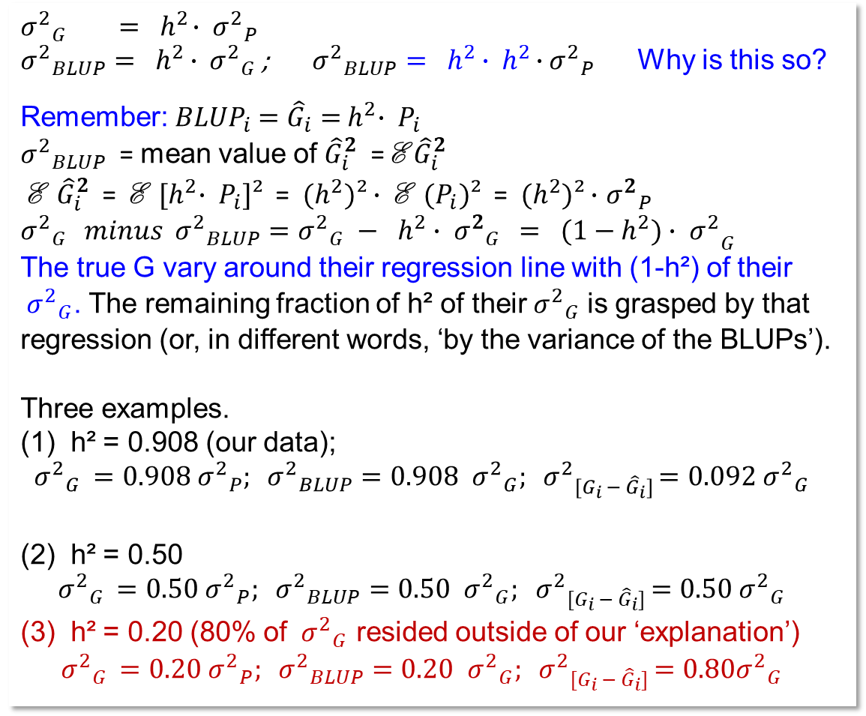
How much of the ${σ^{2}}_{G}$ is ‚explained‘ by the regression of G on P and how much is never-understood – being the variance of ${[G}_{i }− {\hat{G}}_{i}]$ ?
$${σ^{2}}_{G }{ = h}^{2}∙ {σ^{2}}_{P}$$
${σ^{2}}_{BLUP}{= h}^{2 }∙ {σ^{2}}_{G }$; ${σ^{2}}_{BLUP}{= h}^{2 }∙{ h}^{2 }∙{σ^{2}}_{P }$ Why is this so?
Remember:${ BLUP}_{i} ={\hat{G}}_{i}={ h}^{2}∙ P_{i}$
${σ^{2}}_{BLUP}$ = mean value of ${\hat{G}}_{i}^{2}$ = E ${\hat{G}}_{i}^{2}$
E ${\hat{G}}_{i}^{2}$ = E ${[h}^{2}∙ P_{i}]²$ = ${(h}^{2})²∙$ E ${(P}_{i})²$ = ${(h}^{2})²∙$ ${σ^{2}}_{P}$ ${σ^{2}}_{G } minus {σ^{2}}_{BLUP}={σ^{2}}_{G} − h^{2}∙ {σ^{2}}_{G} { {{= (1−h}^{2})∙ σ}^{2}}_{G}$
The true G vary around their regression line with (1-h²) of their ${{ σ}^{2}}_{G}$. The remaining fraction of h² of their${{ σ}^{2}}_{G}$ is grasped by that regression (or, in different words, ‘by the variance of the BLUPs’).
Three examples.
(1) h² = 0.908 (our data);
$${σ^{2}}_{G }=0.908 {σ^{2}}_{P}; {σ^{2}}_{BLUP}{=0.908}^{ }{σ^{2}}_{G}{{; σ}^{2}}_{{[G}_{i }− {\hat{G}}_{i}]}{{=0.092 σ}^{2}}_{G }$$
(2) h² = 0.50
$${σ^{2}}_{G }=0.50 {σ^{2}}_{P}; {σ^{2}}_{BLUP}{=0.50}^{ }{σ^{2}}_{G}{{; σ}^{2}}_{{[G}_{i }− {\hat{G}}_{i}]}{{=0.50 σ}^{2}}_{G }$$
(3) h² = 0.20 (80% of ${σ^{2}}_{G}$ resided outside of our ‘explanation’)
$${σ^{2}}_{G }=0.20 {σ^{2}}_{P}; {σ^{2}}_{BLUP}{=0.20}^{ }{σ^{2}}_{G}{{; σ}^{2}}_{{[G}_{i }− {\hat{G}}_{i}]}{{=0.80σ}^{2}}_{G }$$
26
h²=0.908
h² = 0.20; ${σ^{2}}_{G }=0.20 {σ^{2}}_{P};{{ σ}^{2}}_{BLUP}{={\left(h^{2}\right)}^{2}}^{ }∙{σ^{2}}_{P}$
‚Un-explained‘ ${=[1−{\left(h^{2}\right)}^{2}]{σ^{2}}_{P}=0.96}^{ }{σ^{2}}_{P}$
${ =\left({1−h}^{2}\right){σ^{2}}_{G}{+ (1−h}^{2})}^{ }{{∙σ}^{2}}_{P}$ ${{= 0.96 σ}^{2}}_{P}.$

Slide 27
Estimates of h² from ANOVA suffer strongly if number of environments is small.
Estimated from ANOVA with data from E=2 (G96-0I; H97-0I): h² =0.665. Achieved without ‚knowing‘ the true G values. Mind, the confidence interval (95%) of h² was
-0.25 < h² < 0.91 (DOI 10.1007/BF00260787, implemented in software PLABSTAT). What do we expect as h² based on E=2?
σ²_{G} = 24.42 (dt/ha)²; σ²_{GE} = 29.64 (dt/ha)²
h²_{(E=2)} = 24.42 / (24.42 + 29.64/2) = 0.622
The ‘typical’ h² as expected from data with E=2.
The regression of the ‘true’ G values on the P data (E=2) here: b=0.654; R² = 0.696. The two are not exactly identical and both are ≠ 0.622 The BLUPs shown in the diagram are based on the h² estimate of the ANOVA; h² =0.665.
A combination of any other two environment may have yielded different estimates of h². For instance, data of the two envs. G69-I and H97-0I lead to h² = 0.186.
►Two envs. is, usually, a poor base to estimate h².
Cf. UNPLAB-h²_GxE_Ch-1[Broad Sense h²],
pages 36-41
10
BLUPs via ANOVA-estimated h² (E=2)
8
6
4
2
0
‘True' G effects; BLUP effects
-2
-4
-6
-8
-10
-12
-12
-10
-8
-6
-4
-2
0
2
4
6
8
10
Phenotypic effects (E=2)
27

Slide 28

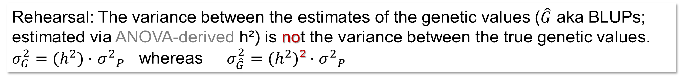
Rehearsal: The variance between the estimates of the genetic values ($\hat{G}$ aka BLUPs; estimated via ANOVA-derived h²) is not the variance between the true genetic values. ${σ_{G}^{2}=(h}^{2})∙$ ${σ^{2}}_{P}$ whereas ${σ_{\hat{G}}^{2}=(h}^{2})²∙$ ${σ^{2}}_{P}$
© G. Welna
And: Via ANOVA we get a result for h² even-though we do not know the true G. Yet, that h² is just an estimate of the true h² and, therefore, the BLUPs are suffering from being estimated from an estimate of h² instead of from the true h² (they are of course different from the true G even if estimated using the true h²).
If data is from few environments, if data is from non-representative environments when having the target area of marketing in mind, in case data is from non-representative weather settings … then our estimation of the true G values is correspondingly noisy, imprecise. Weak. Nota bene.
28

Slide 29
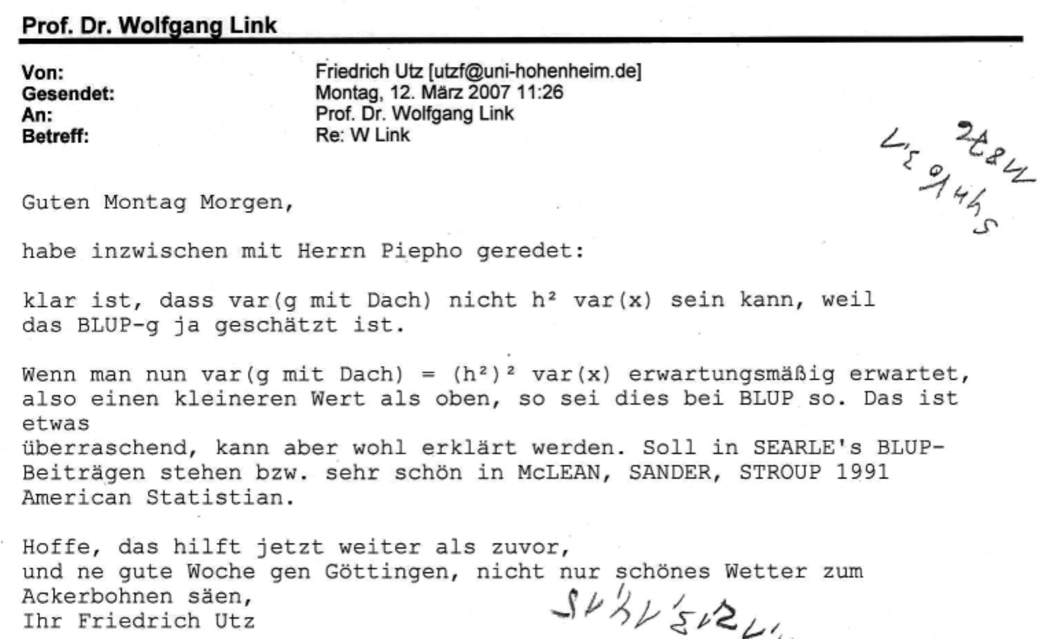
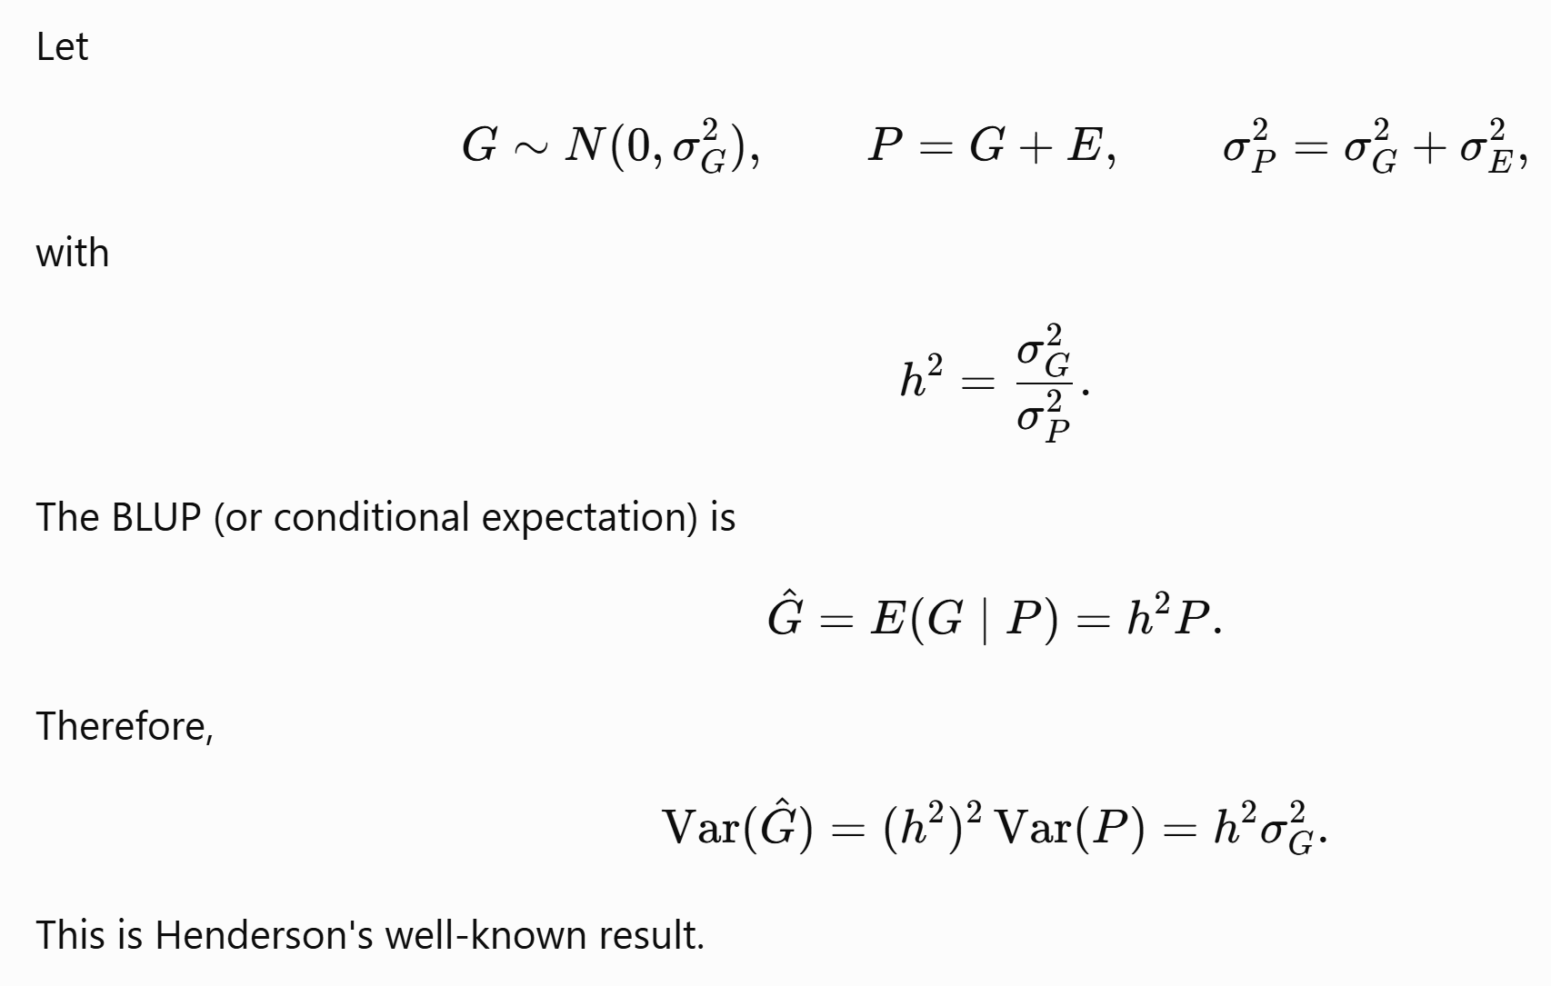
From here you may go to UNPLAB-h²_GxE_Ch-4[Sel.Intensity]
Bonjour M.A. à Rabat, سلام.
Merci d'avoir insisté pour poser cette question à l'époque. Bonjour à tous, bonjour HFU. On voit qu'avec de la persévérance, on peut trouver soi-même des réponses, même si les grands noms de la profession se contentent de nous renvoyer ;-) au lieu de vraiment nous expliquer.
Neither in February 2022 nor in 2007 did I have the option — or the habit — of asking ChatGPT. Yet, in summer 2026, I did so and found that it could explain the issue. Indeed, the US animal breeder Henderson had described this principle slightly ;-) earlier (in 1973) than I had kind-of rediscovered it.
I could have learned about it already in the 1980s, if only I had listened more carefully to Prof. D. K. E. Fewson at Hohenheim ...
29

